Slide 1
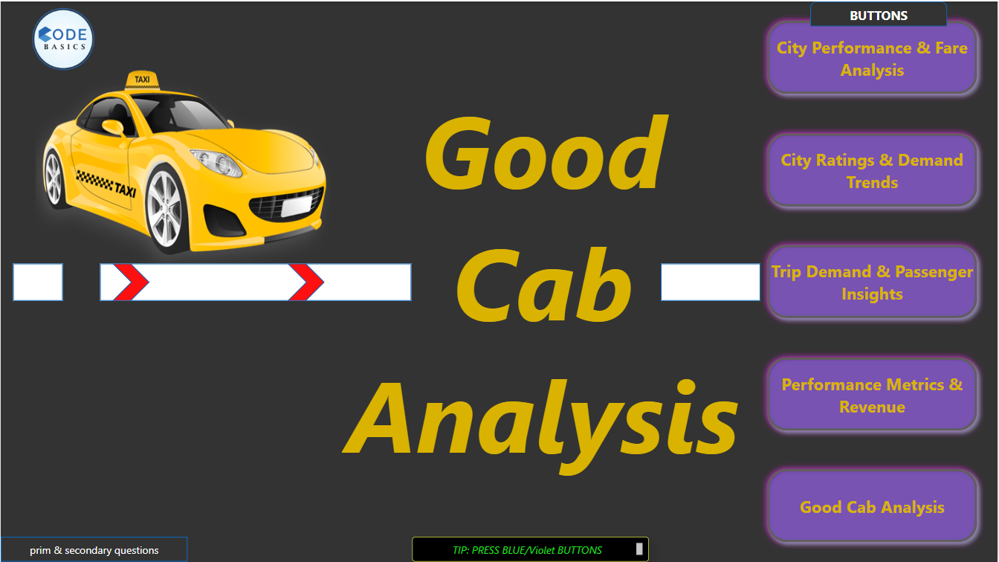

Slide 2

1)Introduction
2)Problem Statement:
: Goodcabs, a cab service focused on tier-2 cities, aims to achieve ambitious performance targets for 2024, including growth and improved passenger satisfaction. To meet these goals, the company needs to assess its performance across key metrics such as trip volume, passenger satisfaction, repeat passenger rate, and trip distribution and Revenue
3)Primary & Secondry Questions about Insights
4)Further Analysis
5)Recommendations

Slide 3
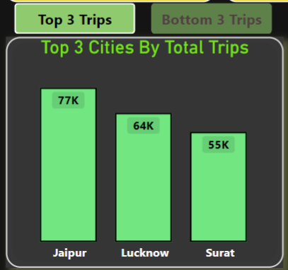
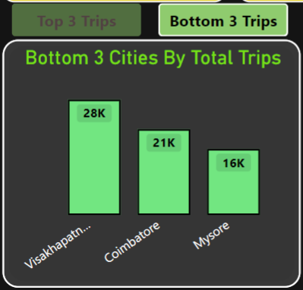
Top and Bottom Performing Cities
⚫Identify the top 3 and bottom 3 cities by total trips over the entire analysis period

Slide 4
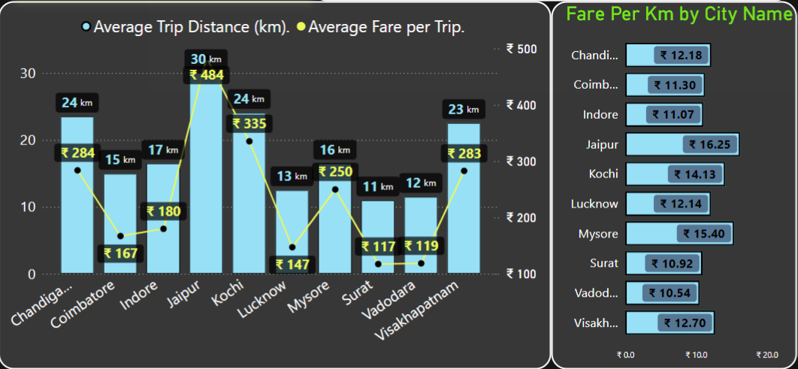
2. Average Fare per Trip by City
⚫Calculate the average fare per trip for each city and compare it with the city's average trip distance. Identify the cities with the highest and lowest average fare per trip to assess pricing efficiency across locations.

Slide 5
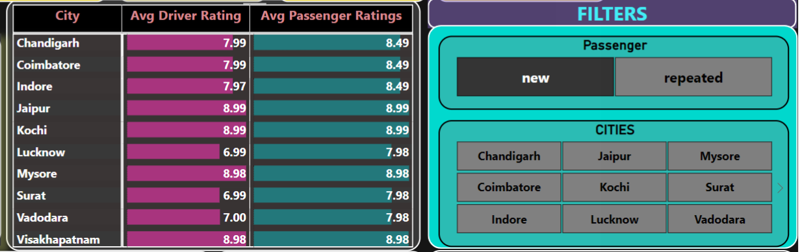
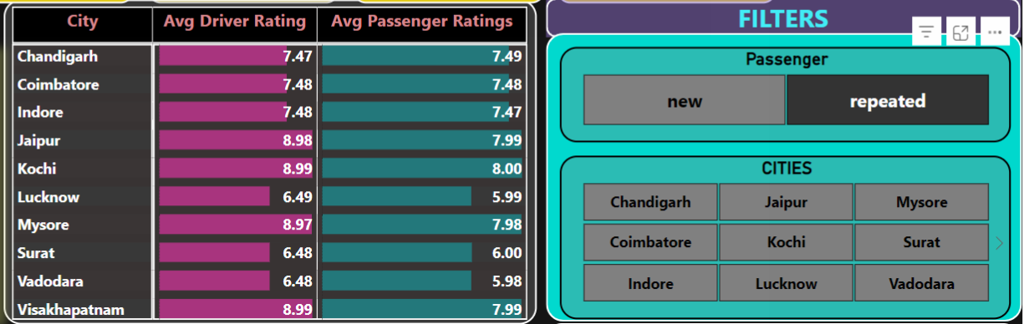
3. Average Ratings by City and Passenger Type
⚫Calculate the average passenger and driver ratings for each city, segmented by passenger
type (new vs. repeat). Identify cities with the highest and lowest average ratings.

Slide 6
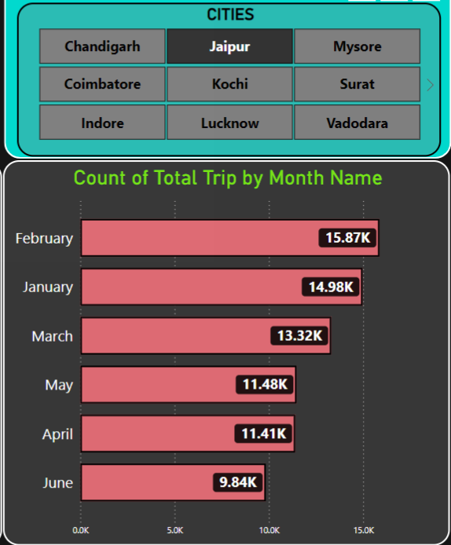
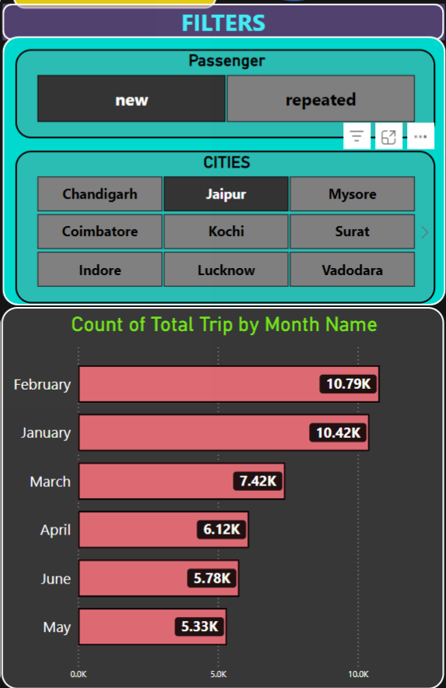
4.Peak and Low Demand Months by City
⚫ For each city, identify the month with the highest total trips (peak demand) and the
month with the lowest total trips (low demand). This analysis will help Goodcabs
understand seasonal patterns and adjust resources accordingly.

Slide 7
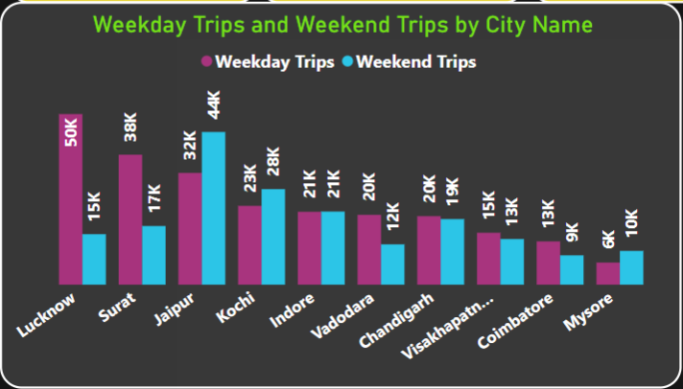
5. Weekend vs. Weekday Trip Demand by City
⚫ Compare the total trips taken on weekdays versus weekends for each city over the six-month period. . Identify cities with a preference for either weekend or weekday trips to understand demand variations.

Slide 8
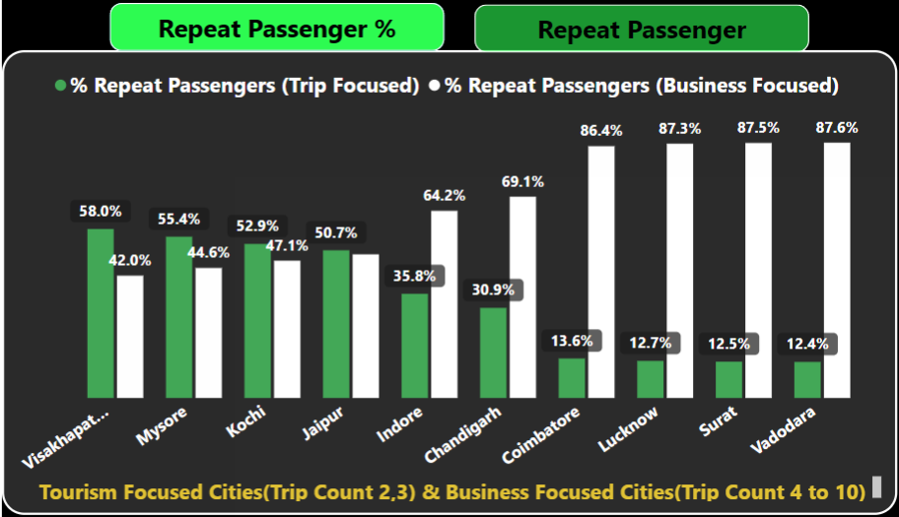
6. Repeat Passenger Frequency and City Contribution Analysis
⚫ Analyse the frequency of trips taken by repeat passengers in each city (e.g., % of repeat passengers taking 2 trips, 3 trips, etc.). Identify which cities contribute most to higher trip frequencies among repeat passengers, and examine if there are distinguishable patterns between tourism-focused and business-focused cities

Slide 9
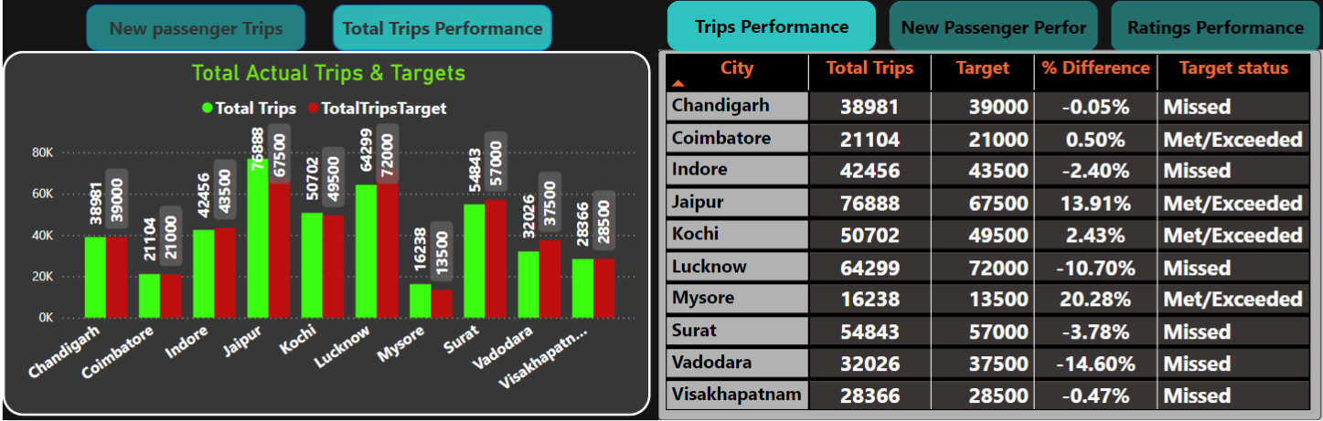
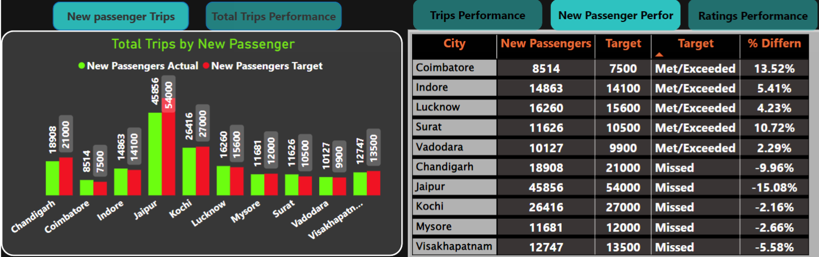
7. Monthly Target Achievement Analysis for Key Metrics
⚫ For each city, evaluate monthly performance against targets for total trips, new passengers, and average passenger ratings from targets_db. Determine if each metric met, exceeded, or missed the target, and calculate the percentage difference. Identify any consistent patterns in target achievement, particularly across tourism versus business-focused cities.
Total Trip Performance
New Passenger Peformance

Slide 10
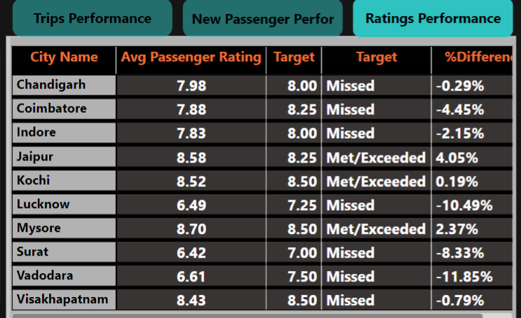
Average passenger ratings

Slide 11
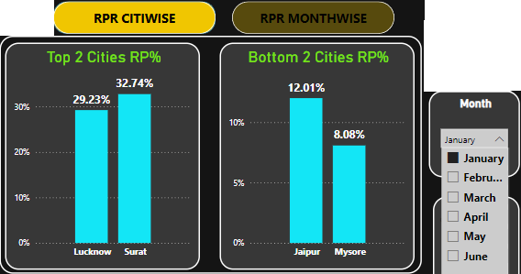
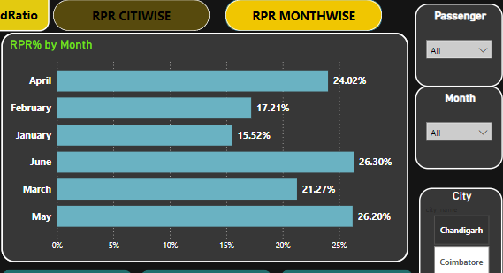
8. Highest and Lowest Repeat Passenger Rate (RPR%) by City and Month
⚫ Analyse the Repeat Passenger Rate (RPR%) for each city across the six- month period. Identify the top 2 and bottom 2 cities based on their RPR% to determine which locations have the strongest and weakest rates.
⚫ Similarly, analyse the RPR% by month across all cities and identify the months with the highest and lowest repeat passenger rates. This will help to pinpoint any seasonal patterns or months with higher repeat passenger loyalty

Slide 12
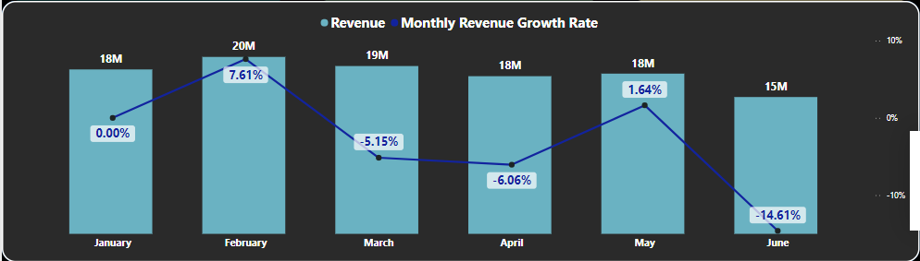
Factors Influencing Repeat Passenger Rates
Q1. What factors (such as quality of service, competitive pricing, or city demographics) might contribute to higher or lower repeat passenger rates in different cities? Are there correlations with socioeconomic or lifestyle patterns in these cities?
1. Cities with Significant Growth:
Jaipur (+129.87%) and Mysore (+203.80%) show notable growth in repeat passenger rates.
Reasons for Success:
Strong customer loyalty.
Better service quality or effective regional promotions.
2. Cities with Declines:
Overall Revenue Drop: June saw a -14.61% decline in revenue, severely impacting business performance.
Cities Facing Challenges: for overall Total repeat passenger
Lucknow (-14.82%), Vadodara (-20.66%), Indore (-6.1%), and Surat (-7.12%).
Key Months of Concern:
January:
Vadodara (-36%)
Lucknow (-24.60%)
June:
Vadodara (-28.04%), Indore (-22.4%), Kochi (-32%).
.

Slide 13
3. Potential Factors for Decline:
Low Service Quality:
Average driver and passenger ratings ~6.6/10, reflecting dissatisfaction with ride experience.
Socioeconomic Factors:
Affordability priorities in industrial hubs like Vadodara and Surat.
Lucknow's demand for improved connectivity.
Lack of Initiatives:
No competitive pricing, loyalty programs, or targeted retention strategies
4. Recommendations for Improvement:
Enhance Service Quality:
Driver training and vehicle maintenance.
Introduce Customer Retention Programs:
Loyalty programs, targeted discounts, and regional campaigns.
Address Seasonal Issues:
Plan for revenue dips during rainy seasons (Kochi, Indore, Vadodara in June).
Fleet Optimization:
Adjust fleet size to meet growing demand in high-growth cities.
5. Cities for Focus:
Jaipur and Mysore:
Benefit from growth but need improvement in driver/passenger ratings to sustain trust.
Low Performing Cities:
Vadodara, Indore, Lucknow, Surat should prioritize increasing repeat passenger rates to boost revenue growth.

Slide 14
Tourism vs. Business Demand Impact
Q. How do tourism seasons or local events (festivals,
conferences) impact "Goodcab" demand patterns? Would tailoring marketing
efforts to these events increase trip volume in tourism-oriented cities?
Key Festivals and Events Driving Growth:
Jaipur:
Events: Jaipur Literature Festival ("Greatest Literary Show on Earth"), Desert Festival, and Elephant Festival (January/February).
Action: Consider increasing fleet size during peak months.
Kochi:
Event: Cochin Carnival Festival in December (a two-week cultural celebration).
Action: Optimize fleet to meet tourist demand.
Mysore:
Event: Mysore Dasara Festival.
Tourism spikes due to landmarks like Mysore Palace and Chamundi Hills
2. Business-Oriented Cities:
Cities such as Indore and Lucknow, with moderate-to-low tourism activity, rely more on business-driven passenger demand.
These cities face challenges in maintaining repeat passenger rates.

Slide 15
3. Recommendations:
Target Tourism-Heavy Cities:
Launch campaigns during peak travel seasons to leverage increased tourist activity.
Fleet Optimization: Ensure sufficient fleet availability during weekends and peak demand periods in cities like Jaipur, Kochi, Mysore, Chandigarh, Indore, and Visakhapatnam.
Tailored Business Packages:
For cities with predominantly business clients (e.g., Indore and Lucknow), introduce business-friendly incentives to improve repeat passenger rates.
Revenue Contribution Focus:
Jaipur (37.21M) and Kochi (17M) together account for 50% of total revenue (108M).
Prioritize these cities to achieve both new and repeat passenger targets for strong revenue growth.

Slide 16
3. Emerging Mobility Trends and Goodcabs' Adaptation
Q. What emerging mobility trends (such as electric vehicle adoption, green energy use) are
impacting the cab service market in tier-2 cities? Should Goodcabs consider integrating
electric vehicles or eco-friendly initiatives to stay competitive?
Insights:
o Jaipur's (130%) and Mysore (210%) repeat passengers high growth might align with its
investment in EVs or green initiatives, appealing to environmentally conscious
travelers.
• Recommendations:
o Explore integration of EVs or hybrid vehicles to align with sustainability goals.
o Leverage government subsidies for EV adoption in tier-2 cities.

Slide 17
4. Partnership Opportunities with Local Businesses
Q. Are there opportunities for Good-cabs to partner with local businesses (such as hotels,
event venues) to boost demand and improve customer loyalty? Could these partnerships
drive more traffic, especially in tourism-heavy or high-footfall areas?
Partnership Opportunities with Local Businesses
Insights:
• Cities like Kochi (which met 95% of its target) and Mysore (203% growth) are high performers and could benefit further from local partnerships:
o Hotels, malls, and airports can boost passenger volume.
o Collaborations in Jaipur and Mysore could drive repeat passengers further due to their
high growth rates.
Recommendations:
• Partner with event organizers in Jaipur to attract tourists during cultural festivals.
• Build alliances with hotels in Kochi to promote cab services for tourists and business travelers.

Slide 18
5. Data Collection for Enhanced Data-Driven Decisions
Q .To make Good-cabs more data-driven and improve its performance across key metrics
(such as repeat passenger rate, customer satisfaction, new passengers and trip volume),
what additional data should Good-cabs collect? Consider data that could provide deeper
insights.
Customer Feedback:
Qualitative insights on why passengers may not return (service issues, pricing, ride quality).
Ratings for drivers, vehicles, and overall ride experience.
Competitor Analysis:
Data on competitors’ pricing, discounts, loyalty programs, and service quality to identify gaps and opportunities.
Demographic Data:
Information like age, income levels, purpose of travel, and frequent travel destinations to design targeted offers and campaigns.

Slide 19
Trip-Specific Data:
Peak Hours: Identify at what times customers are most likely to book rides.
Frequent Days: Analyze which days of the week see the most bookings.
Trip Distance: Average miles traveled per ride to optimize pricing and fleet allocation.
Drop-off and Pickup Hotspots: Identify high-demand areas for better fleet placement.
Customer Booking Patterns:
Understand seasonal trends (e.g., tourism seasons, festivals, weather impacts) to align fleet and marketing strategies.
Identify months with the lowest bookings to implement targeted promotions.
Driver Performance Metrics:
Ratings, trip completion rates, and availability during peak times to address service quality gaps.

Slide 20
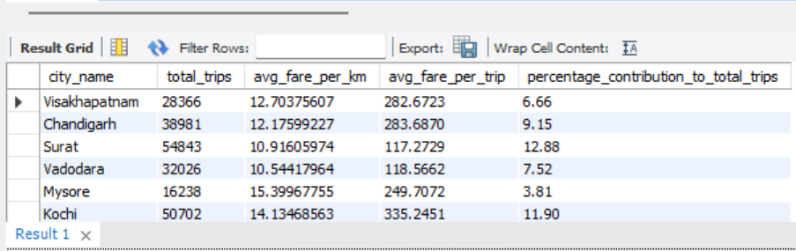
Ad-Hoc-requests
Business Request - 1: City-Level Fare and Trip Summary Report
Generate a report that displays the total trips, average fare per km, average fare per trip, and the percentage contribution of each city’s trips to the overall trips. This report will help in assessing trip volume, pricing efficiency, and each city’s contribution to the overall trip count.
Fields:
city name
totaI_trips
avg_fare_per_km
avg fare per trip
%_contribution_to_totaI_trips

Slide 21
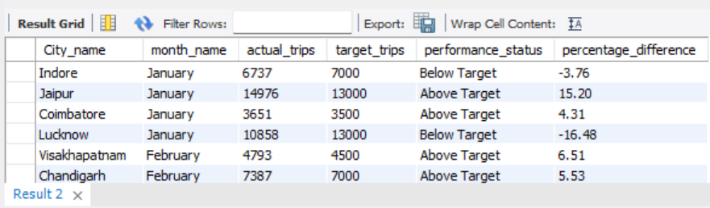
Business Request - 2: MonthIy City-Level Trips Target Performance Report
Generate a report that evaluates the target performance for trips at the monthly and city level. For each city and month, compare the actual total trips with the target trips and categorise the performance as follows:
If actual trips are greater than target trips, mark it as "Above Target".
If actual trips are less than or equal to target trips, mark it as "Below Target".
Additionally, calculate the % difference between actual and target trips to quantify the performance gap.
Fields:
City_name
month name
actual trips
target_trips
performance status % difference

Slide 22
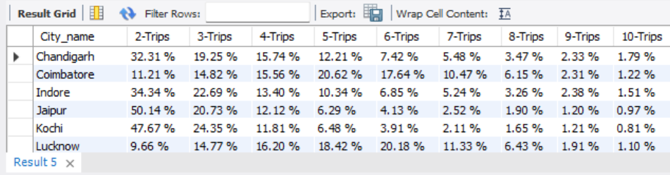
Business Request - 3: City-Level Repeat Passenger Trip Frequency Report
Generate a report that shows the percentage distribution of repeat passengers by the number of trips they have taken in each city. Calculate the percentage of repeat passengers who took 2 trips, 3 trips, and so on, up to 10 trips.
Each column should represent a trip count category, displaying the percentage of repeat passengers who fall into that category out of the total repeat passengers for that city.
This report will help identify cities with high repeat trip frequency, which can indicate strong customer loyalty or frequent usage patterns.
Fields: city name, 2-Trips, 3-Trips, 4-Trips, 5-Trips, 6-Trips, 7-Trips, 8-Trips, 9-Trips, 10-Trips

Slide 23
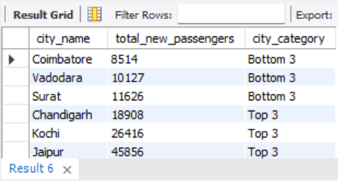
Business Request - 4: Identify Cities with Highest and Lowest Total New Passengers
Generate a report that calculates the total new passengers for each city and ranks them based on this value. Identify the top 3 cities with the highest number of new passengers as well as the bottom 3 cities with the lowest number of new passengers, categorising them as "Top 3" or "Bottom 3" accordingly.
Fields
city name
totaI_new_passengers
city_category ("Top 3" or "Bottom 3")

Slide 24
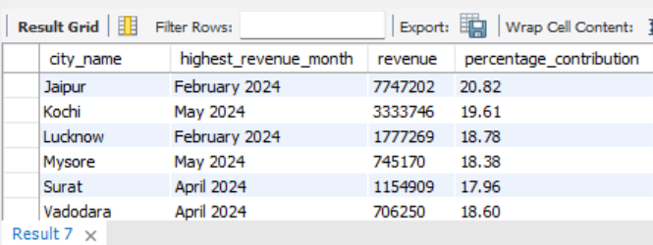
Business Request - 5: Identify Month with Highest Revenue for Each City
Generate a report that identifies the month with the highest revenue for each city. For each city, display the month name, the revenue amount for that month, and the percentage contribution of that month’s revenue to the city’s total revenue.
Fields
city_name
highest revenue month
revenue
percentage contribution (%)

Slide 25
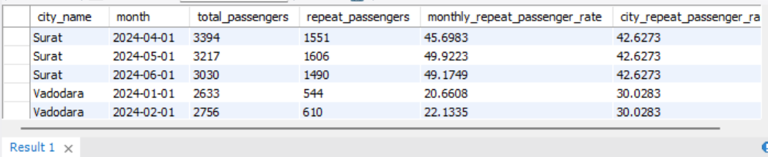
Business Request - 6: Repeat Passenger Rate Analysis Generate a report that calculates two metrics:
Monthly Repeat Passenger Rate: Calculate the repeat passenger rate for each city and month by comparing the number of repeat passengers to the total passengers.
City-wide Repeat Passenger Rate: Calculate the overall repeat passenger rate for each city, considering all passengers across months.
These metrics will provide insights into monthly repeat trends as well as the overall repeat behaviour for each city.
Fields
City name
Month
totaI_passengers
repeat_passengers
monthly repeat passenger rate (%): Repeat passenger rate at the city and month level
city repeat_passenger rate (%): Overall repeat passenger rate for each city, aggregated across months

Slide 26
Thank You

